Slide 1
Introduction to Python Session - 2
Sachin Chorge
April 2022

Slide 2
List comprehension
List comprehensions are used for creating new lists from other iterables like tuples, strings, arrays, lists, etc. A list comprehension consists of brackets containing the expression, which is executed for each element along with the for loop to iterate over each element.
Basic syntax:
new_list = [fn(x) for x in old_list if x==something]
Advantages of List comprehension :
More time efficient and space efficient than loops
Require fewer lines of code
Transforms iterative statements into formulas

Slide 3
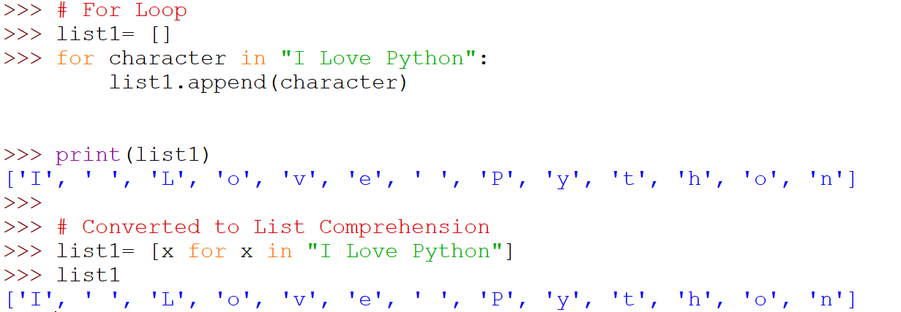
Difference between for loop and comprehension

Slide 4
Difference between for loop and comprehension

Slide 5
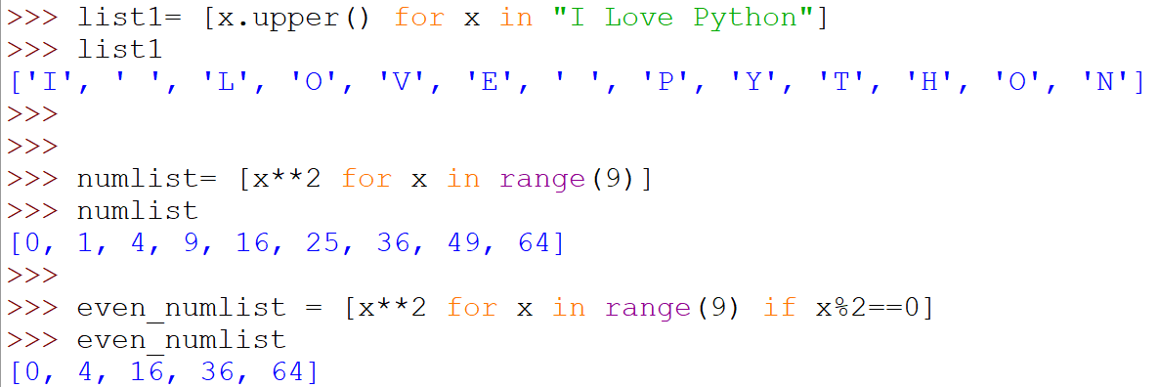
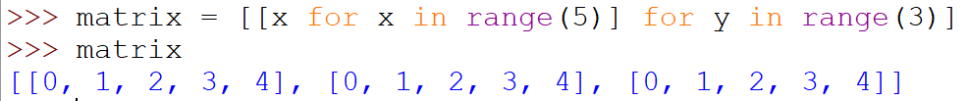
Applying function in List comprehension

Slide 6
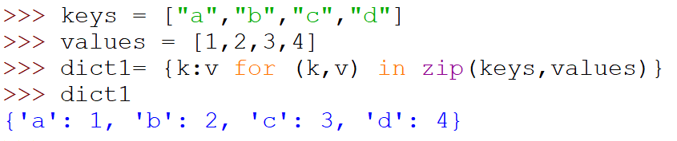
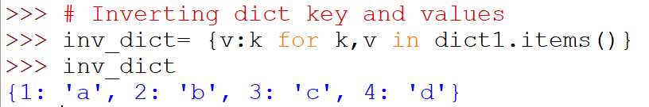
Dictionary comprehension

Slide 7
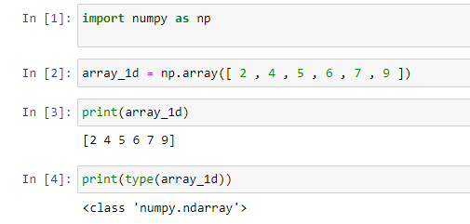
numpy
numpy is a library used in scientific computing and data analysis. It stands for ‘Numerical Python’.
The most basic object in numpy is ndarray or array , which is an n-dimensional array.
Installing numpy using pip:
Before using numpy, you have import the library into the code first

Slide 8
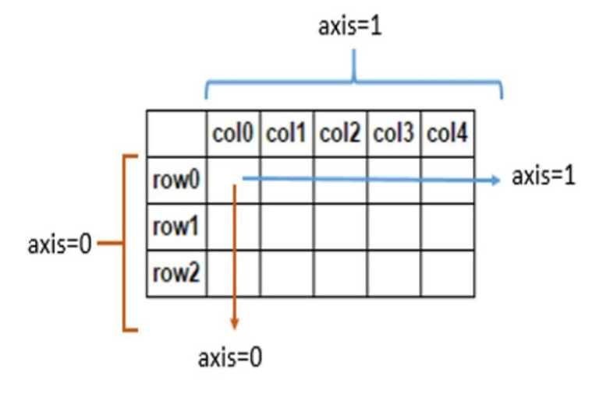
numpy Array
In numpy, dimensions are called axes.
Terminology for 2-D arrays.
axis 0 refers to rows
axis 1 refers to columns

Slide 9
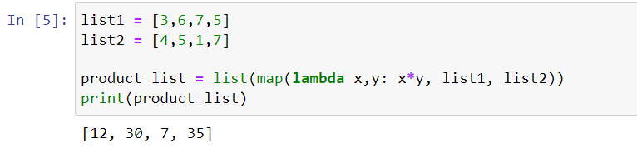
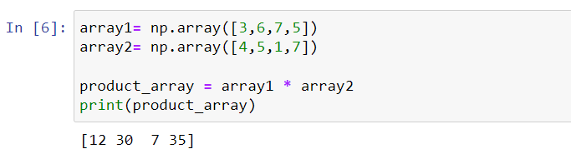
Difference between list calculations and numpy calculations

Slide 10
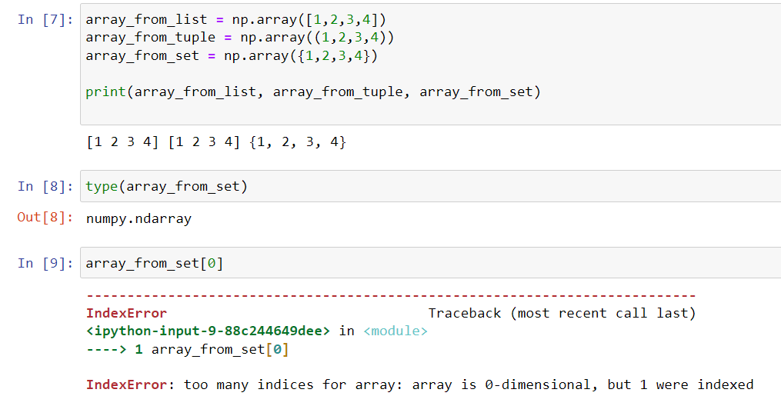
Basic functions - numpy

Slide 11
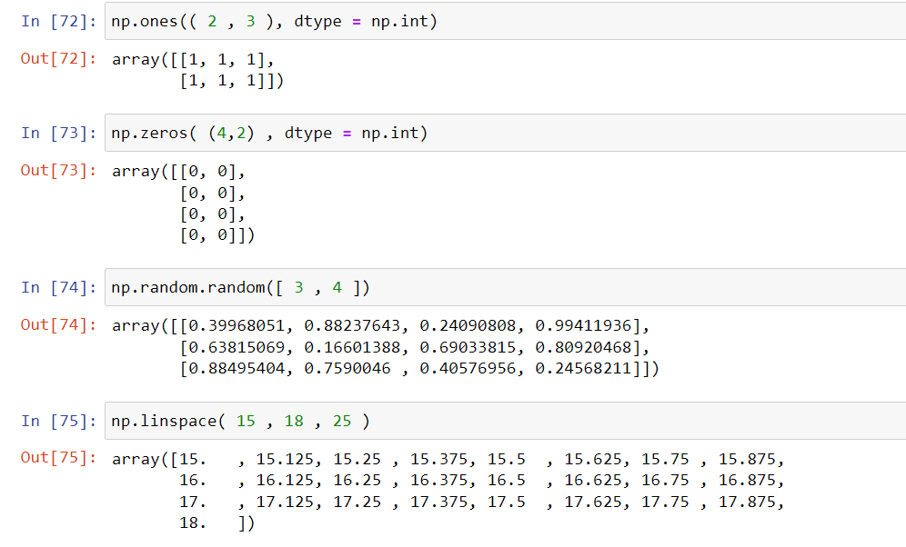
Basic functions - numpy

Slide 12
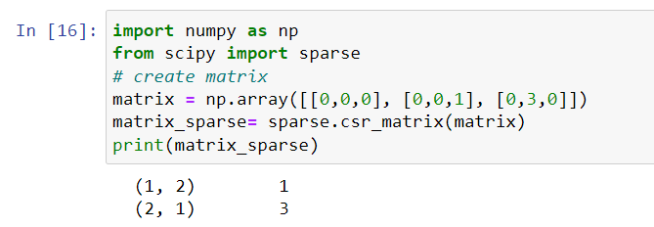
Vector operations – sparse matrix
A frequent situation in machine learning is having a huge amount of data; however, most of the elements in the data are zeros. For example, imagine a matrix where the columns are every movie on Netflix, the rows are every Netflix user, and the values are how many times a user has watched that particular movie. This matrix would have tens of thousands of columns and millions of rows! However, since most users do not watch most movies, the vast majority of elements would be zero.
Sparse matrices only store nonzero elements and assume all other values will be zero, leading to significant computational savings. In our solution, we created a numpy array with two nonzero values, then converted it into a sparse matrix. If we view the sparse matrix we can see that only the nonzero values are stored:

Slide 13
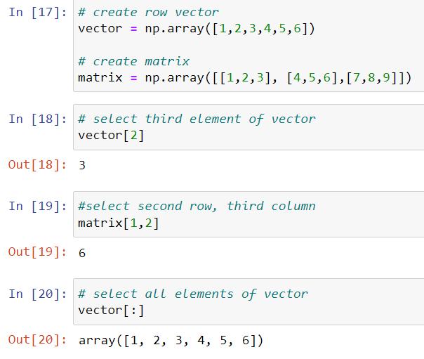
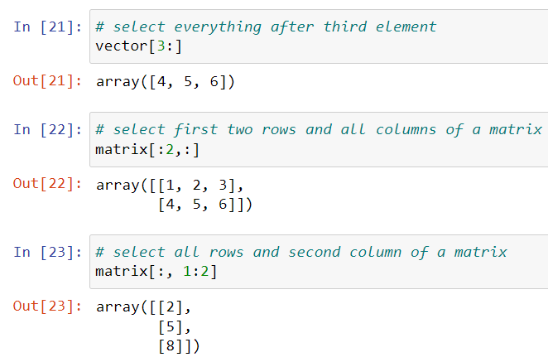
Selecting Elements – numpy vectors and matrix

Slide 14
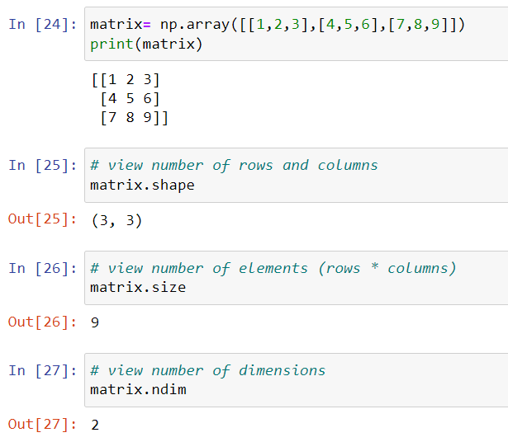
Describing a matrix

Slide 15
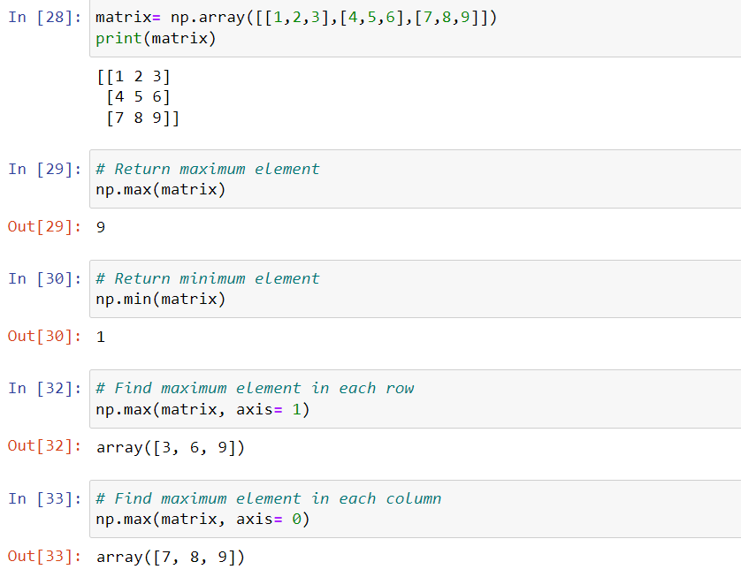
Finding max and min values in a matrix

Slide 16
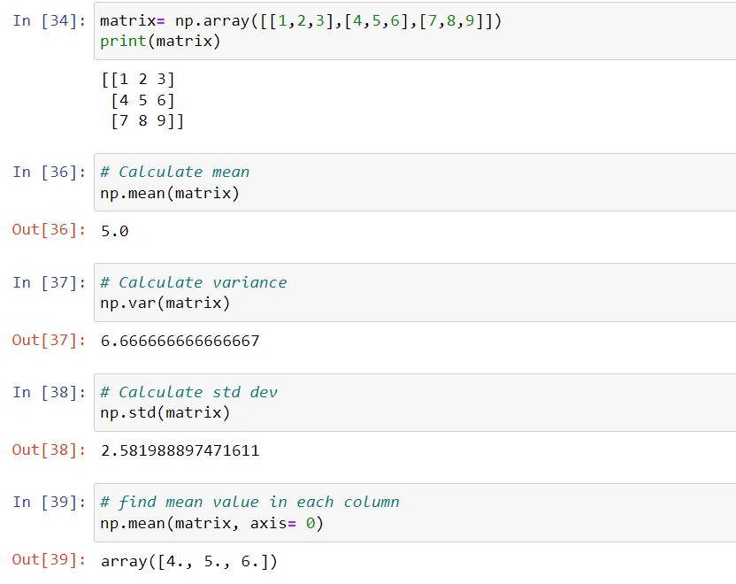
Calculate descriptive statistics about an array

Slide 17
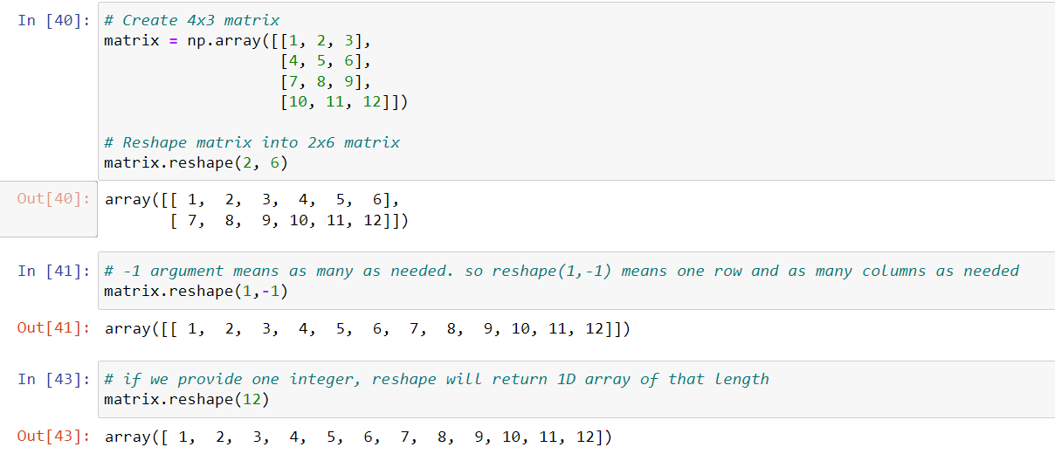
Reshaping arrays
Reshaping arrays allows us to restructure an array so that we maintain the same data but it is organized as a different number of rows and columns. The only requirement is that the shape of the original and new matrix contain the same number of elements (i.e., the same size).

Slide 18
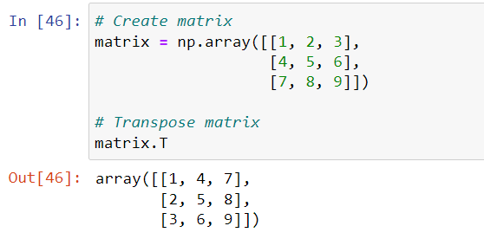
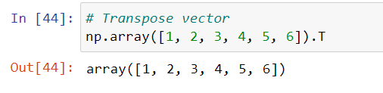
Transposing a matrix
Transposing is a common operation in linear algebra where the column and row indices of each element are swapped.
Make a note that a vector cannot be transposed because it is just a collection of values

Slide 19
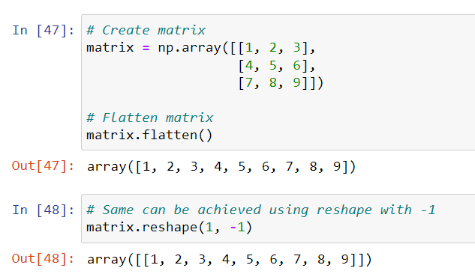
Flattening of a matrix
flatten is a simple method to transform a matrix into a one-dimensional array. Alternatively, we can use reshape to create a row vector

Slide 20
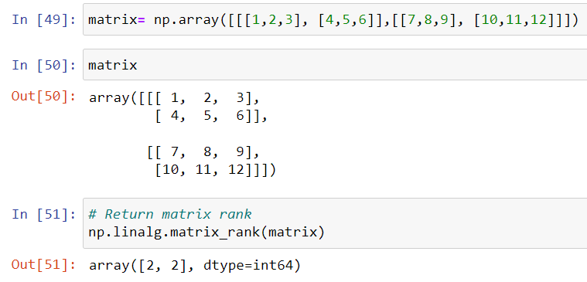
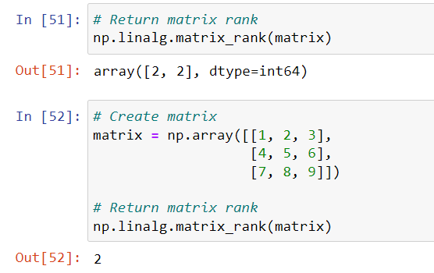
Rank of a matrix
The rank of a matrix is the dimensions of the vector space spanned by its columns or rows.

Slide 21
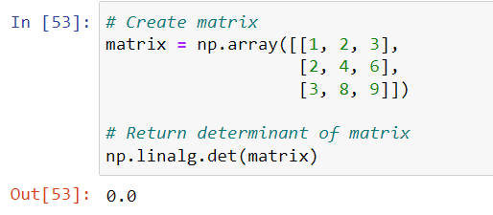
Determinant of a matrix
Refer this link for detailed explanation.
https://www.mathsisfun.com/algebra/matrix-determinant.html

Slide 22
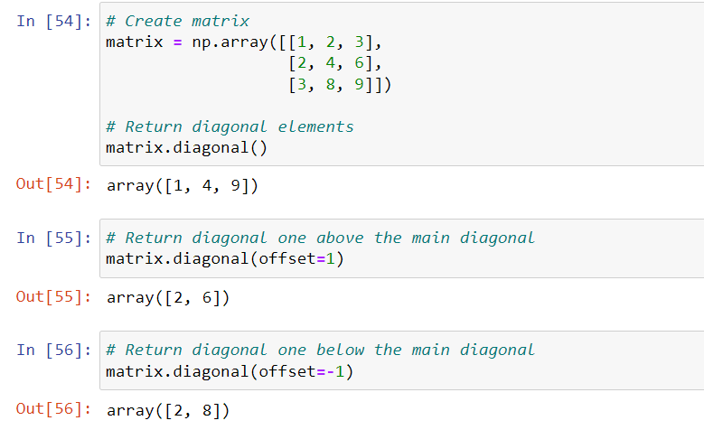
Diagonal of a matrix
NumPy makes getting the diagonal elements of a matrix easy with diagonal. It is also possible to get a diagonal off from the main diagonal by using the offset parameter

Slide 23
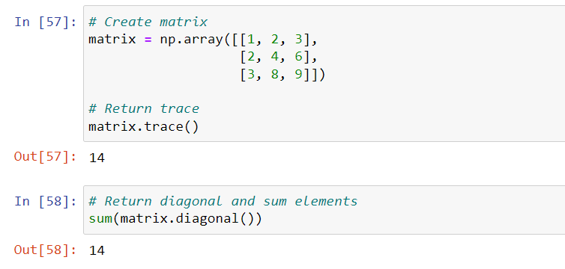
Trace of a matrix
The trace of a matrix is the sum of the diagonal elements and is often used under the hood in machine learning methods. Given a NumPy multidimensional array, we can calculate the trace using trace. We can also return the diagonal of a matrix and calculate its sum

Slide 24
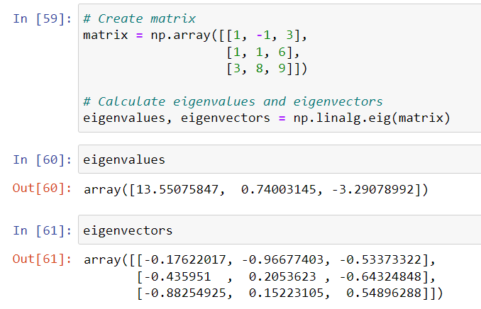
Eigen Values and Eigen Vectors
Eigenvectors are widely used in machine learning libraries. Intuitively, given a linear transformation represented by a matrix, A, eigenvectors are vectors that, when that transformation is applied, change only in scale (not direction). More formally:
A v = λ v
where A is a square matrix, λ contains the eigenvalues and v contains the eigenvectors. In NumPy’s linear algebra toolset, eig lets us calculate the eigenvalues, and eigenvectors of any square matrix.
https://www.mathsisfun.com/algebra/eigenvalue.html

Slide 25
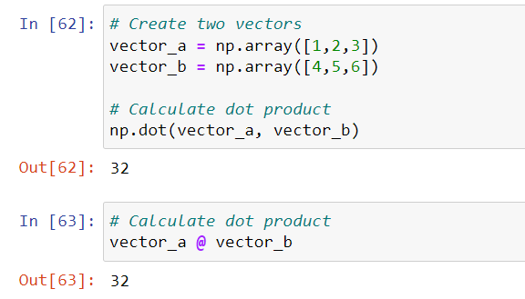
Dot product of two vectors
https://www.mathsisfun.com/algebra/vectors-dot-product.html
Dot product = a.b= a * b * cos(theta) where theta is angle between two vectors.

Slide 26
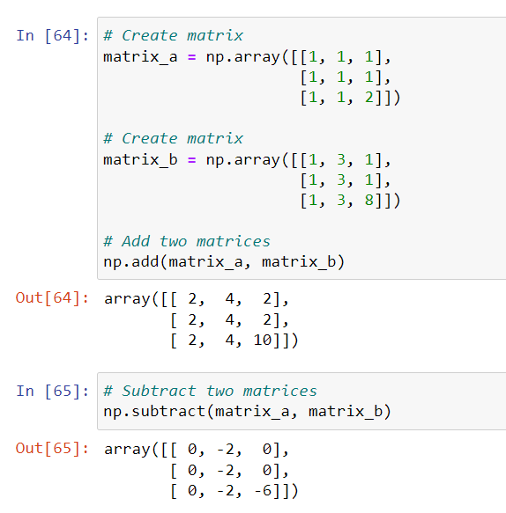
Addition/Subtraction of two vectors

Slide 27
Dot product of two vectors
https://www.mathsisfun.com/algebra/vectors-dot-product.html
Dot product = a.b= a * b * cos(theta) where theta is angle between two vectors.

Slide 28
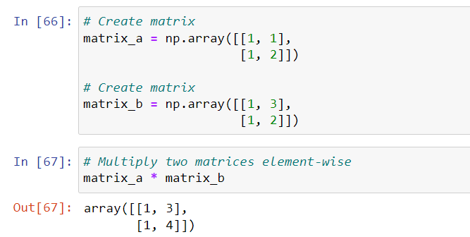
Cross product of two vectors
https://www.mathsisfun.com/algebra/vectors-cross-product.html

Slide 29
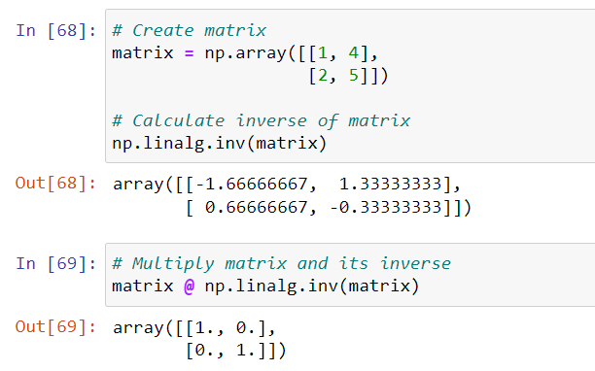
Inverse of a Matrix
The inverse of a square matrix, A, is a second matrix A–1, such that:
A A -1 = I
where I is the identity matrix. In NumPy we can use linalg.inv to calculate A–1 if it exists.

